Slide 1

Smart Cane for Visually Impaired Team Members: 1) 21BLC1472 – S Vinodh 2) 21BLC1569 – A Navaneth
Project Guide – Dr. Karthikeyan PR

Slide 2
Introduction
Motivation and Background
Visual impairment affects millions globally, significantly limiting their independence and mobility in daily life.
Conventional white canes are passive tools that help detect obstacles only within their physical range, offering minimal assistance in complex environments such as crowded streets, traffic intersections, or unfamiliar areas.
There is a growing need for smarter assistive technologies that go beyond basic obstacle detection and provide real-time situational awareness, navigation, and emergency alerts.
Recent advancements in embedded systems, IoT, and wireless communication make it possible to design cost-effective, intelligent mobility aids for the visually impaired.

Slide 3
Introduction
Overview of the Smart Cane System
This project proposes a Smart Cane that integrates sensor-based monitoring, cloud-based data handling, and mobile communication to assist visually impaired users.
Core components of the system include:
Obstacle Detection to prevent collisions.
Fall Detection with instant caretaker notifications.
GPS Location Tracking for real-time monitoring.
Turn-by-Turn Navigation using audio feedback.
A companion mobile application enables caregivers to receive alerts, track location, and remotely assist the user if needed.

Slide 4
Problem Statement
Limited Situational Awareness for the Visually Impaired: Navigating public and unfamiliar environments remains a significant challenge for visually impaired individuals, especially due to their reliance on basic white canes that offer no proactive sensing of obstacles or environmental context.
High Risk in Dynamic Outdoor Environments: Environments such as busy streets, crowded areas, and uneven terrains present risks of collisions, falls, or disorientation. Without smart assistance, users face difficulties in maintaining safety and independence.
Delayed Emergency Response in Fall Incidents: In cases of accidental falls, visually impaired individuals may not be able to call for help promptly. The absence of an automatic detection and alert mechanism can lead to delayed medical attention or caregiver intervention.
Lack of Real-Time Connectivity with Caregivers: Caregivers and family members often lack visibility into the real-time safety and location status of the user, leading to increased anxiety and difficulty in providing timely assistance.
Need for an Integrated, Non-Intrusive Assistive Technology: Existing solutions often address only one aspect (like obstacle detection or navigation), and may require bulky or separate devices. There is a need for a unified solution that is practical, reliable, and easy to use in daily life.

Slide 5
Research Objectives
Assistive Navigation System: Design and develop a Smart Cane to aid visually impaired users in navigating independently and safely.
Fall Detection and Alert Mechanism: Detect user falls using accelerometer and gyroscope and notify caregivers in real-time via Firebase and mobile notifications.
Real-Time Location Tracking: Continuously track and upload GPS coordinates to Firebase for live monitoring by caregivers.
Turn-by-Turn Audio Navigation: Guide users with voice directions using GPS-based navigation steps played through a speaker.
Seamless App-Hardware Communication: Maintain synchronized, real-time data exchange between the ESP32-based cane and the Android application using Firebase services.
Performance Evaluation: Assess the system’s effectiveness in terms of location accuracy, fall detection reliability, and overall user-friendliness.

Slide 6
Proposed System - Introduction
The proposed system is a Smart Cane designed to assist visually impaired individuals by integrating multiple features into a single, compact solution. It combines real-time GPS tracking, fall detection, obstacle detection, and voice-based navigation feedback using a speaker. The system uses an ESP32 microcontroller as the central controller, interfaced with sensors and modules including an MPU6050 accelerometer-gyroscope, NEO-6M GPS module, ultrasonic sensors, and an I2S DAC.
The Smart Cane communicates with a custom-built Android application through Firebase, ensuring real-time data synchronization. The app enables caregivers to monitor the user’s location, receive fall alerts, and send destination-based navigation instructions to the cane. This integration aims to enhance the autonomy and safety of visually impaired users in outdoor environments, providing both navigational aid and emergency communication.

Slide 7
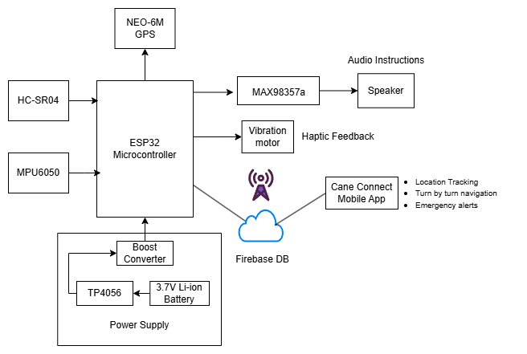
Proposed System Diagram

Slide 8
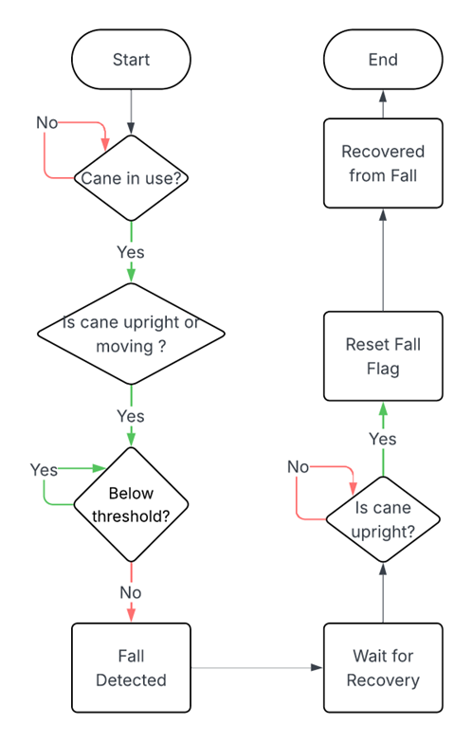
Fall Detection System
Sensor Integration and Data Acquisition: The MPU6050 sensor continuously collects acceleration and gyroscope data along the X, Y, and Z axes using the I2C protocol. The ESP32 processes this data in real time to monitor the cane’s motion and orientation.
Algorithm Flow: The system uses a state-based algorithm (FallState enum).
If the cane’s X or Z acceleration exceeds a threshold and Y-axis drops, it enters FALL_DETECTED.
It checks for near-zero gyroscope movement (|gyroX|, |gyroY|, |gyroZ| < 0.1) to confirm the cane is stationary.
If confirmed, it transitions to FALL_CONFIRMED and updates the fallDetected flag in Firebase Realtime Database.
If the cane returns to an upright position (accelY > 7.5), it resets to NO_FALL.
App Integration: The mobile app listens to fall updates through a foreground service and displays immediate local notifications using FallDetectionService, even after device reboot (via BootReceiver).

Slide 9
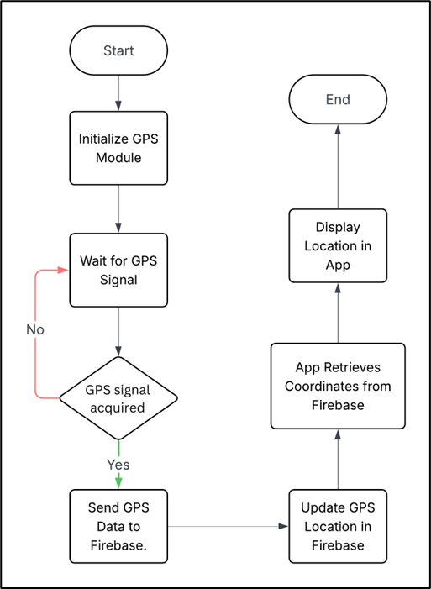
GPS and Location Tracking Module
Location Acquisition and Transmission: The NEO-6M GPS module is used to continuously acquire the real-time geographic coordinates of the user. The TinyGPSPlus library running on the ESP32 parses this data into readable latitude and longitude values.
Algorithm Flow:
The ESP32 reads GPS data via UART, parses it using TinyGPSPlus, and pushes updated coordinates to Firebase Realtime Database every 5 seconds.
These updates are performed over Wi-Fi, ensuring consistent cloud synchronization.
App Integration: The mobile application listens to the GPS node in Firebase and reflects the live location of the cane on Google Maps. The app uses LocationViewModel to track location changes and update the map dynamically in real time.

Slide 10
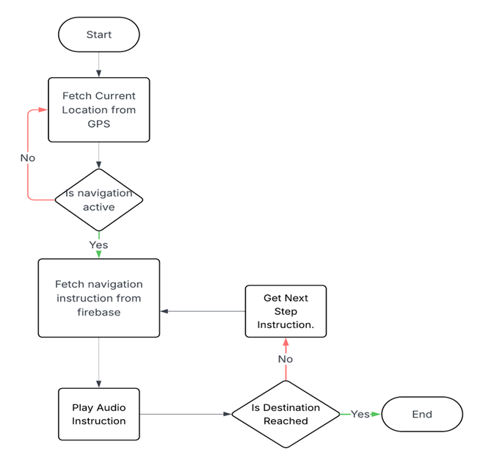
Route Generation and Data Structuring: When a caregiver selects a destination from the app, the Google Directions API is used to generate a sequence of steps, each containing instruction text, location (latitude, longitude), and an audio file reference.
Algorithm Flow:
Steps are stored in Firestore under RouteDetails.
ESP32 fetches and compares current GPS coordinates with the target step.
If within a 10m radius, the corresponding audio is played.
After the final step, Nav_Flag is set to false, ending the navigation session.
App Integration: The app prepares and uploads all route instructions and audio links to Firestore. It also sets Nav_Flag = true to signal navigation has started. Once completed, the flag is reset.
Turn-by-turn Navigation

Slide 11
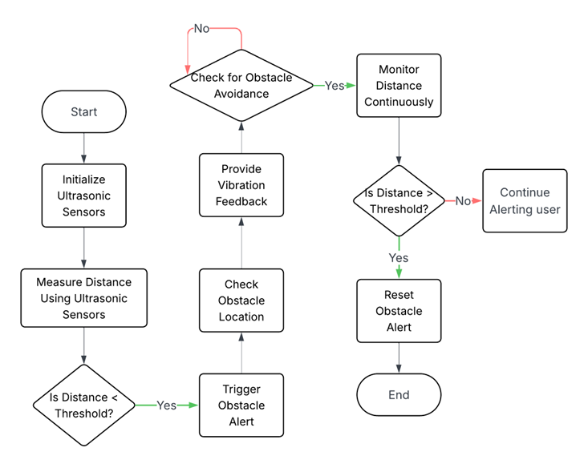
Object Detection and Proximity Handling: Three ultrasonic sensors positioned on the front, left, and right sides of the cane measure the distance to nearby obstacles. Readings are processed by the ESP32 using the time-of-flight method.
Algorithm Flow:
A trigger pulse is sent and echo time is measured.
Distance is calculated using: Distance = (duration × 0.034) / 2.
If distance is between 5 cm and 100 cm, a vibration motor is activated to warn the user.
Haptic Feedback:
The Smart Cane uses simple vibration-based haptic feedback to alert the user when an obstacle is detected or when navigation instructions are received. This allows the user to stay aware of their surroundings , thus improving safety and ease of use during movement.
Audio Feedback: Navigation instructions stored as audio files in Firebase Storage are fetched and played via the MAX98357A I2S DAC and a connected speaker. Playback is triggered when the user reaches a navigation step location.
Obstacle Detection and User Alert

Slide 12
Data Synchronization and Communication: Firebase forms the central communication backbone that links the Smart Cane hardware with the caregiver’s mobile app. The ESP32 microcontroller continuously updates sensor data—such as GPS coordinates and fall detection flags—to Firebase Realtime Database, while structured navigation steps and audio file references are stored in Firestore. Additionally, audio files for navigation are stored in Firebase Storage.
Algorithm Flow:
ESP32 gathers sensor data and constructs JSON objects for upload.
Periodically, it updates designated nodes in the Firebase Realtime Database using secure HTTPS calls.
For navigation, the system retrieves updated route instructions from Firestore, which includes GPS points, textual directions, and links to corresponding audio files.
Audio assets are stored in Firebase Storage and are referenced by Firestore, enabling the Smart Cane to fetch and play them when required.
Firebase Integration

Slide 13
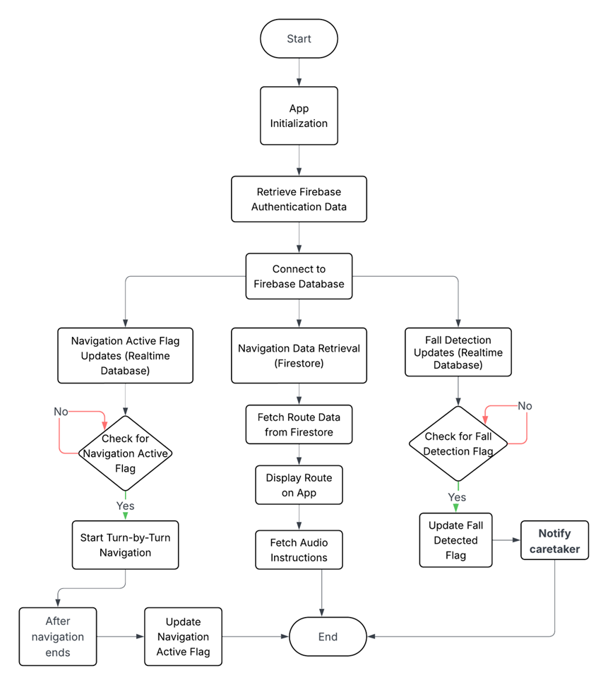
Firebase Integration
App Integration:
The mobile application employs real-time listeners on both Firebase Realtime Database and Firestore to continuously monitor the user’s location, navigation status, and fall alerts.
Upon detecting changes—such as a fall notification or updated GPS coordinates—the app immediately updates the user interface and triggers local notifications for caregivers.
This bi-directional data flow ensures that both the Smart Cane and mobile app remain synchronized, providing timely updates and responses for enhanced user safety and navigation accuracy.

Slide 14
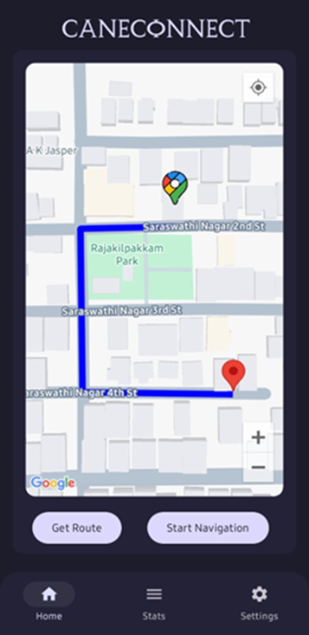
Cane Connect Mobile Application
The Cane Connect mobile application serves as the interface between the caregiver and the Smart Cane, enabling real-time monitoring and remote assistance.
It retrieves live GPS coordinates and fall detection flags from Firebase Realtime Database, displaying the cane's position on a Google Maps interface.
Navigation instructions and audio file links are stored in Firestore; the app facilitates route generation via the Google Directions API and uploads these structured steps.
The app employs background services and local notifications to alert caregivers immediately on detection of a fall or abnormal event, ensuring timely emergency response.
Built using Android's modern development frameworks (Jetpack Compose, Kotlin, and ViewModel), the app maintains reactive UI updates and seamless data synchronization through Firebase.
The overall integration enables bidirectional communication: the Smart Cane sends sensor data to Firebase, while the mobile application updates navigation parameters and alerts in real time.

Slide 15
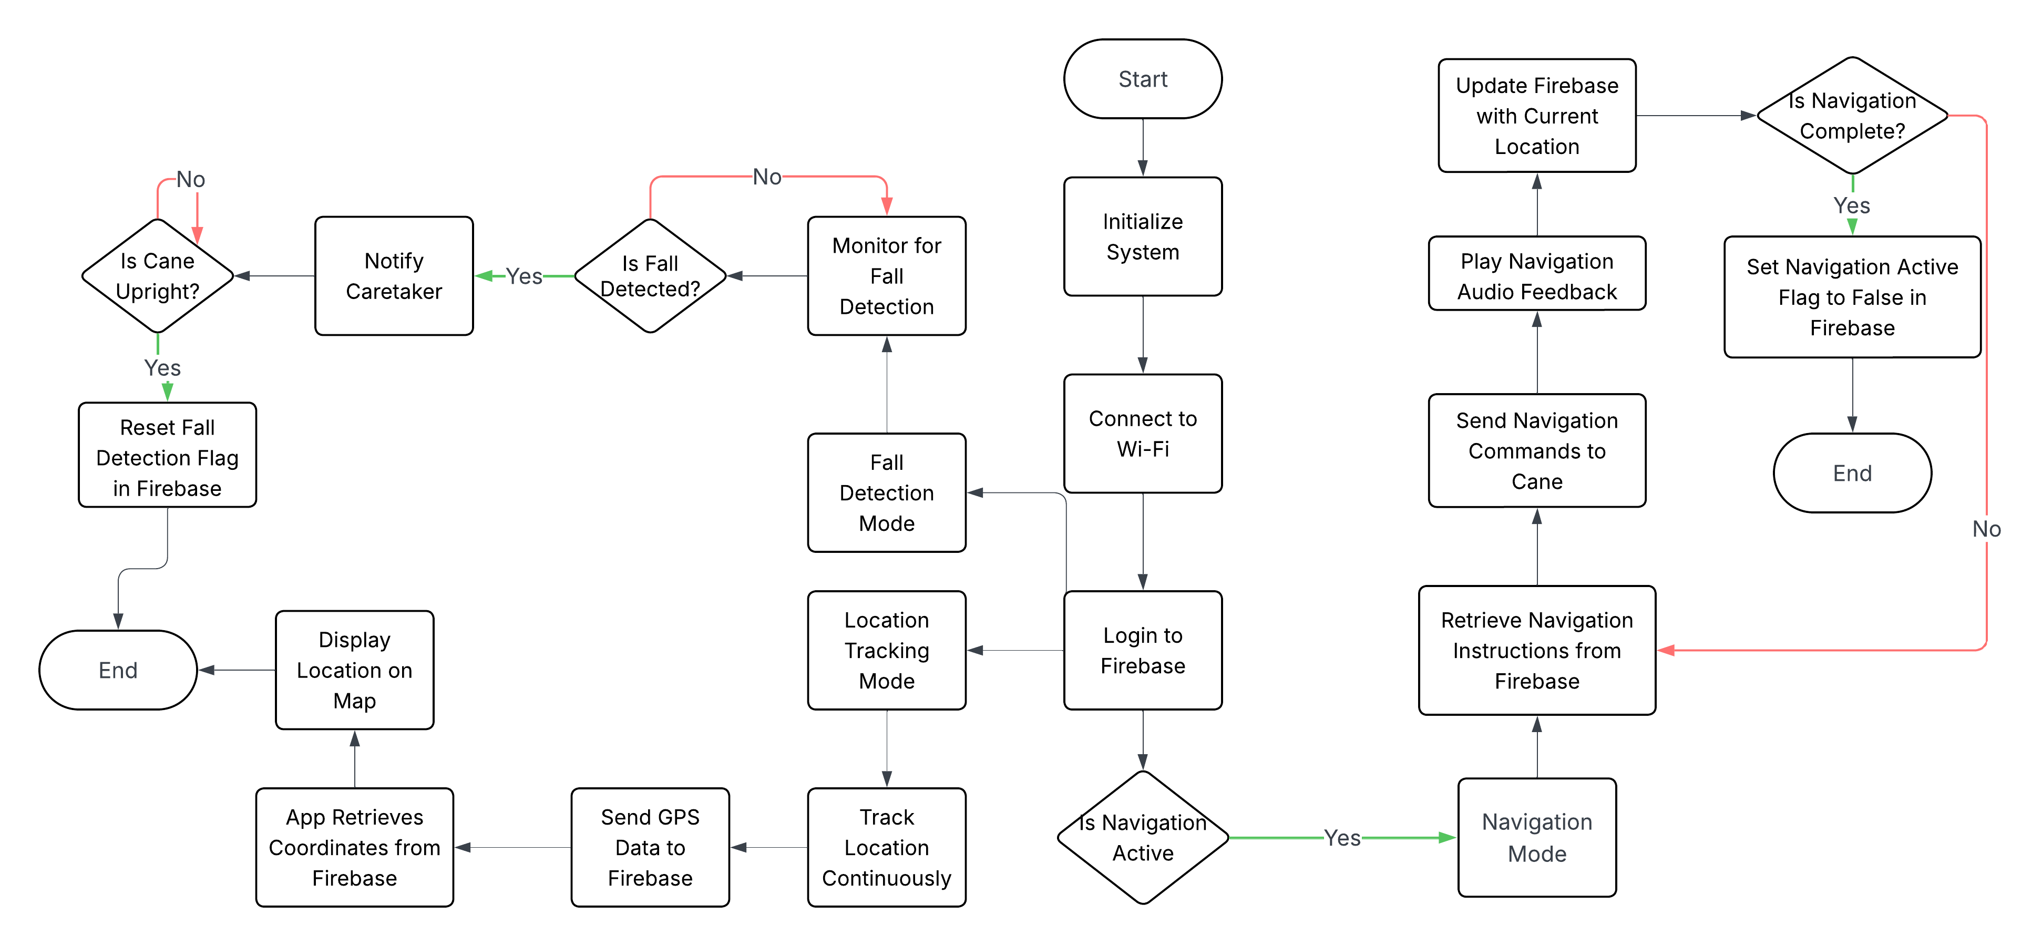
Cane Connect Mobile Application
Flowchart illustrating the working of the mobile application

Slide 16
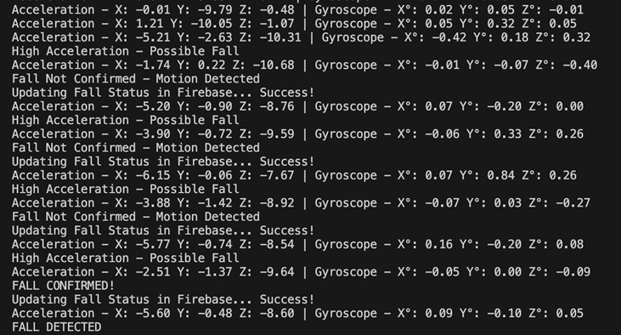
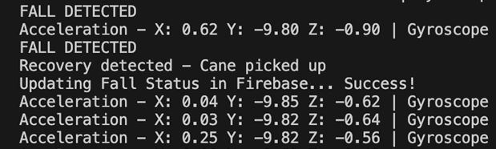
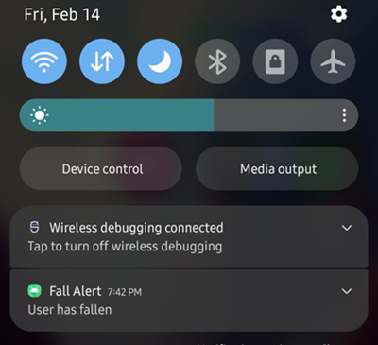
Results
Fall Detection
The MPU6050 sensor continuously monitored acceleration and orientation, identifying fall events when sudden changes were detected.
The system confirmed a fall by checking low gyroscope values and then updated the fallDetected flag on Firebase.
The mobile app immediately displayed a high-priority notification to alert caregivers.
Recovery was detected when the cane returned to an upright position, automatically resetting the flag.

Slide 17
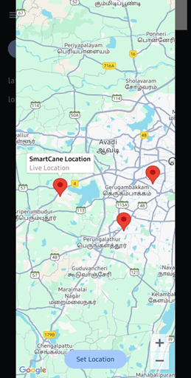
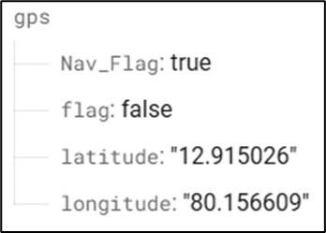
Results
GPS and Location Tracking
The NEO-6M GPS module provided continuous latitude and longitude data to the ESP32.
Location data was parsed using the TinyGPSPlus library and uploaded to Firebase Realtime Database every few seconds.
The mobile app displayed the cane’s real-time location using Google Maps API.
Accurate position updates were observed during testing, with minimal delay.

Slide 18
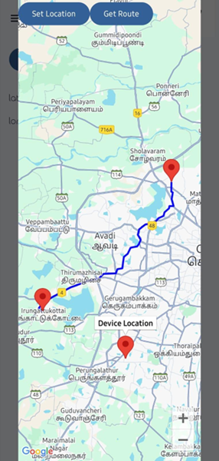
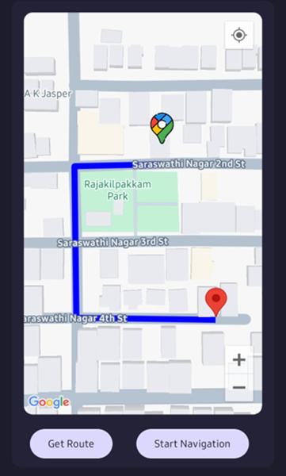

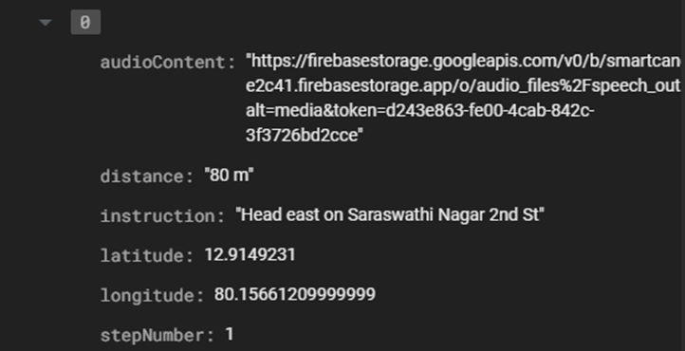
Results
Turn-by-Turn Navigation
Navigation instructions were generated using the Google Directions API in the mobile app.
Each step (latitude, longitude, instruction, audio link) was uploaded to Firestore under RouteDetails.
The ESP32 compared live GPS coordinates with step points and played the corresponding audio using the I2S DAC.
Audio cues were triggered accurately at each navigation point during testing.

Slide 19
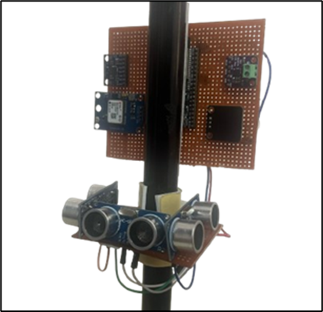
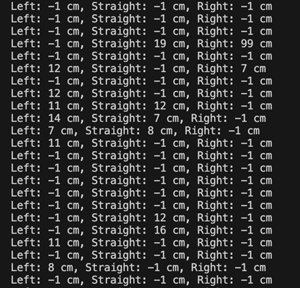
Results
Obstacle Detection and Audio Feedback
Ultrasonic sensors on the front, left, and right continuously monitored for obstacles.
When an object was detected within the 5–100 cm range, the ESP32 activated the vibration motor for haptic feedback.
The obstacle detection was responsive and directional during real-world tests.
For navigation, audio files were fetched from Firebase Storage and played using the MAX98357A I2S DAC and speaker.
The audio feedback was clear and triggered at the correct GPS locations.

Slide 20
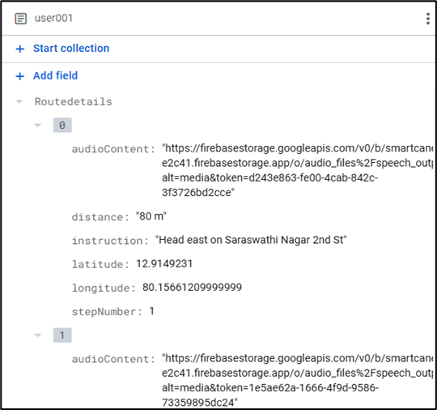
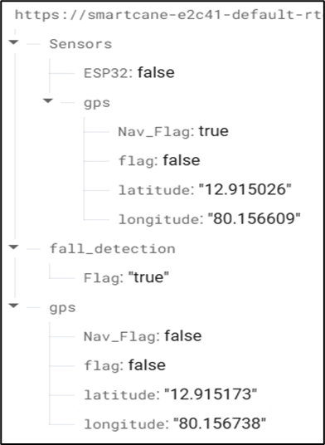
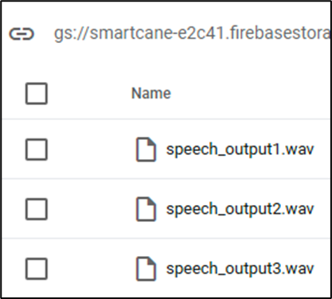
Results
Firebase Integration Results
Firebase Realtime Database was used to sync GPS coordinates, fall status, and system flags in real time.
Firestore stored structured navigation steps including audio links for each waypoint.
Firebase Storage hosted WAV audio files, which were accessed by the Smart Cane during navigation.
The app and ESP32 communicated seamlessly with Firebase, ensuring synchronized data flow.

Slide 21
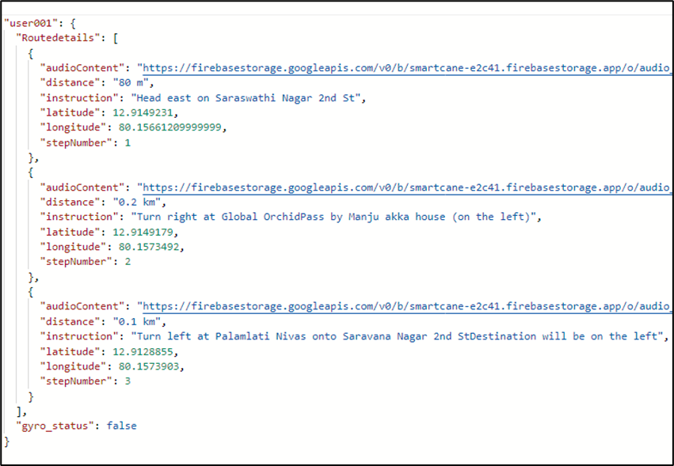
Results
Firebase Integration Results
Firestore DB structure

Slide 22

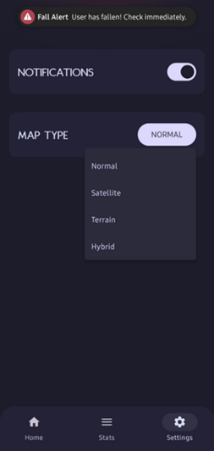
Results
Cane Connect Mobile App
The mobile app served as a real-time interface for caregivers to monitor cane activity.
It displayed the user's live location using Google Maps and tracked fall detection status.
Caregivers received immediate local notifications when a fall was detected.
The app generated navigation routes using the Google Directions API and uploaded step-by-step instructions to Firestore.
Background services ensured continuous alerts and tracking even when the app was closed.

Slide 23
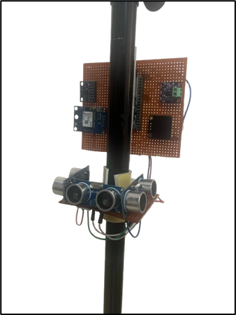
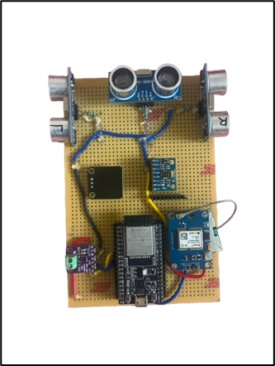
Results
Prototype Integration and Assembly
All hardware modules—MPU6050, NEO-6M GPS, ultrasonic sensors, MAX98357A DAC, and ESP32—were successfully integrated on a compact PCB setup.
Components were powered using a rechargeable 3.7V Li-ion battery power circuit for portability.
The complete system was assembled onto a standard cane, allowing for mobility testing in outdoor conditions.

Slide 24
Results
System Performance Summary & Interpretation
All core functionalities—fall detection, obstacle alert, GPS tracking, and navigation—were successfully implemented and tested.
Fall detection using the MPU6050 was accurate, with reliable confirmation through gyroscope values and minimal false positives.
Navigation audio instructions triggered precisely at the intended GPS waypoints, with smooth audio playback via I2S DAC.
Obstacle detection effectively alerted the user using vibration feedback within the 5–100 cm range.
GPS tracking was real-time and consistently reflected on the mobile app using Firebase and Google Maps.
Mobile app notifications were instant, even when running in the background, ensuring continuous caregiver awareness.
Overall, the system operated with minimal latency, stable cloud communication, and effective real-world responsiveness.

Slide 25
Results
Discussion and Limitations
Audio Output Volume: The onboard speaker volume is low in noisy outdoor environments, which may affect instruction clarity.
ESP32 Memory Limitations: Limited flash/RAM restricts the number and size of audio files that can be buffered during navigation.
Ultrasonic Range Constraints: HC-SR04 sensors are limited to ~2 meters and may not reliably detect thin or fast-moving obstacles, reducing overall obstacle awareness.
Connectivity Dependency: The Smart Cane relies on internet connectivity for features like navigation and alerts. In areas with poor network coverage, these functions may not work reliably.

Slide 26
Standards Used
IEEE 802.11 (Wi-Fi): Enables wireless data transmission between the ESP32 and Firebase for real-time updates of GPS, fall status, and navigation data.
NMEA 0183 (GPS Communication Protocol): Standard protocol used by the NEO-6M GPS module to transmit satellite data, parsed by the ESP32 for real-time location tracking.
I2C (Inter-Integrated Circuit): Communication standard used between the ESP32 and MPU6050 sensor for efficient transfer of accelerometer and gyroscope data.
I2S (Inter-IC Sound): Used to stream digital audio from the ESP32 to the MAX98357A DAC for high-quality audio playback during navigation.
UART (Universal Asynchronous Receiver-Transmitter): Serial communication protocol used between ESP32 and GPS module for receiving NMEA sentences.
HTTP (Hypertext Transfer Protocol): Used by the ESP32 to securely communicate with Firebase (Firestore, Realtime Database, and Storage) over Wi-Fi.

Slide 27
Conclusion and Future Work
Conclusion:
The Smart Cane system successfully integrates real-time fall detection, obstacle alert, GPS tracking, and audio-based navigation.
Cloud connectivity via Firebase ensures timely data synchronization with the mobile app, keeping caregivers informed.
The system enhances the safety, awareness, and mobility of visually impaired users in outdoor environments.
Future Work:
Develop a compact, attachable casing for better portability and protection.
Improve audio clarity using a mini amplifier and high-power speaker.
Integrate deep learning models for object recognition and intelligent fall prediction.
Add a vision module or LiDAR for object classification and enhanced obstacle detection.

Slide 28
References
S. F. Sibu, B. S. Kumar, A. T. Joseph, K. J. Raina, V. P. Joseph and T. Thomas, "CNN based Smart Cane: A tool for Visually Impaired People," 2023 9th International Conference on Smart Computing and Communications (ICSCC), Kochi, Kerala, India, 2023, pp. 126-131, doi: 10.1109/ICSCC59169.2023.10334996.
S. Khan, S. Nazir and H. U. Khan, "Analysis of Navigation Assistants for Blind and Visually Impaired People: A Systematic Review," in IEEE Access, vol. 9, pp. 26712-26734, 2021, doi: 10.1109/ACCESS.2021.3052415.
K. Jivrajani et al., "AIoT-Based Smart Stick for Visually Impaired Person," in IEEE Transactions on Instrumentation and Measurement, vol. 72, pp. 1-11, 2023, Art no. 2501311, doi: 10.1109/TIM.2022.3227988.
W. -J. Chang, L. -B. Chen, C. -Y. Sie and C. -H. Yang, "An Artificial Intelligence Edge Computing-Based Assistive System for Visually Impaired Pedestrian Safety at Zebra Crossings," in IEEE Transactions on Consumer Electronics, vol. 67, no. 1, pp. 3-11, Feb. 2021, doi: 10.1109/TCE.2020.3037065.
T. Lavanya Narayani., M. Sivapalanirajan., B. Keerthika., M. Ananthi. and M. Arunarani., "Design of Smart Cane with integrated camera module for visually impaired people," 2021 International Conference on Artificial Intelligence and Smart Systems (ICAIS), Coimbatore, India, 2021, pp. 999-1004, doi: 10.1109/ICAIS50930.2021.9395840.
T. P. Viet, B. N. Minh, T. T. Van, H. T. Manh, N. D. Tan and P. N. Huu, "Smart Stick Detecting Obstacles Early Using Random Forest Algorithm," 2024 4th International Conference of Science and Information Technology in Smart Administration (ICSINTESA), Balikpapan, Indonesia, 2024, pp. 720-724, doi: 10.1109/ICSINTESA62455.2024.10748104.
R. Ghatkamble, K. Ratish Kumar, S. John Hrithik, J. Harshith Kumar and P. S. Sujan, "Computer Vision and IoT-Based Smart System for Visually Impaired People," 2023 International Conference on Artificial Intelligence and Applications (ICAIA) Alliance Technology Conference (ATCON-1), Bangalore, India, 2023, pp. 1-5, doi: 10.1109/ICAIA57370.2023.10169589.
A. Supekar and S. Patil, "Design and Development of Portable Navigation System for Disabled Person using Image, Text and Audio," 2022 IEEE Delhi Section Conference (DELCON), New Delhi, India, 2022, pp. 1-4, doi: 10.1109/DELCON54057.2022.9753410.
S. Zafar et al., "Advancement in Smart Cane Technology: Enhancing Mobility for the Visually Impaired Using ROS and LiDAR," 2024 International Conference on Robotics and Automation in Industry (ICRAI), Rawalpindi, Pakistan, 2024, pp. 1-6, doi: 10.1109/ICRAI62391.2024.10893984.

Slide 29
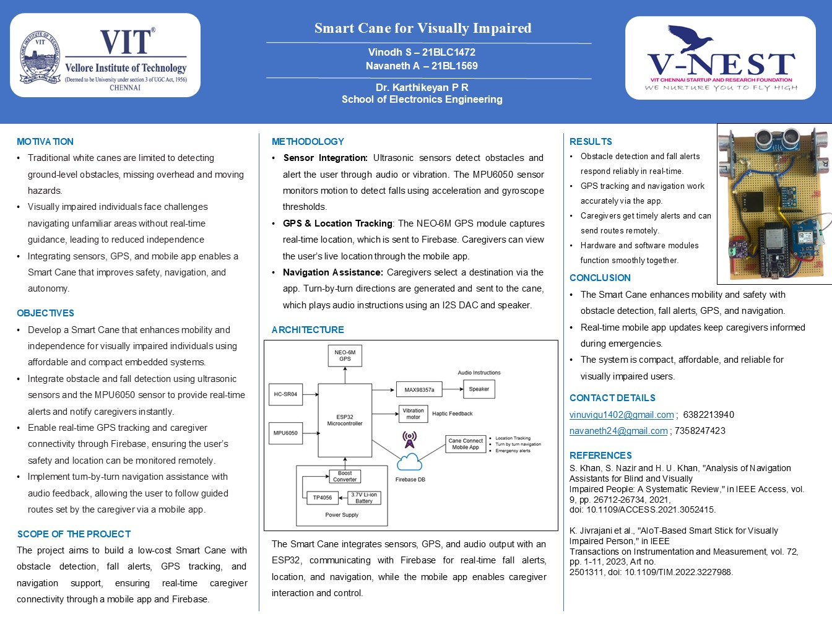
Poster

Slide 30
Thank You

